Slide 1
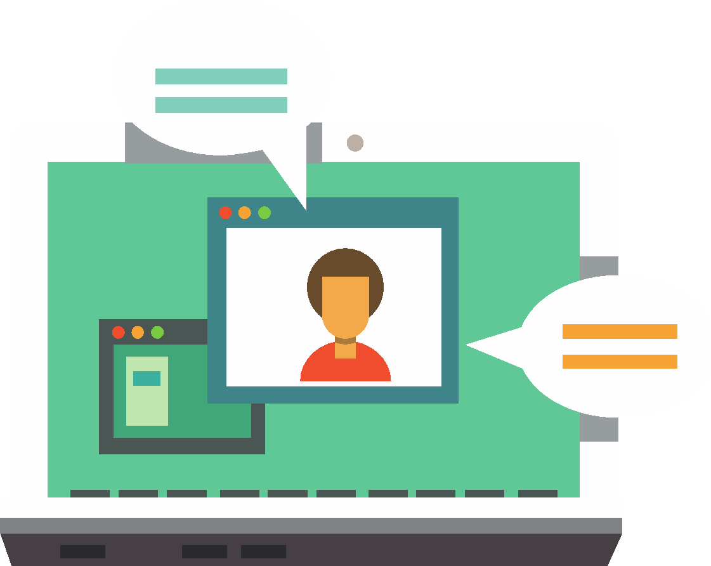
Getting started
Lesson 3: The internet and digital wellbeing

Slide 2
Objectives
In this lesson, you will learn:
appropriate use of digital resources
using the internet for research
digital wellbeing.

Slide 3


Slide 4
The internet
The internet is a global network that connects computers across the world so that they can communicate with one another.
These computers include servers hosting software, music and video that you can access via the internet.
The internet is somewhere to:
find out information
watch videos
play games
connect with friends
Something else?

Slide 5

What should you use the internet for at school?
Accessing and handing in work via the VLE
Research
Emailing teachers

Slide 6

What should you not use the internet for at school?
Playing games
Watching videos or listening to music*
Messaging friends
*Unless this is something you have been asked to do as part of a lesson.

Slide 7
Information on the internet
There is a great deal of fantastic stuff on the internet and it is a really useful place to gather information about all sorts of subjects.
However, alongside all the accurate information there is a lot of unreliable and even incorrect and misleading information.
Some websites are written by non-specialists who present their own thoughts and ideas on a subject as facts.
Other websites are written by very knowledgeable people but are biased because they present just one side of the story.

Slide 8
How can we work out if information on the internet is trustworthy?
Look out for:
Accuracy: Are there facts and figures to back up opinions?
Currency: When was the article written? Has it been updated recently?
Author: Is the author named? Are they qualified to comment on the subject they are writing about?
Hosting website: Is the organisation hosting the website well known and generally considered to be trustworthy?
Balanced presentation: Are both sides of an argument covered in equal measure?
Professional tone: Is the article well written? It should avoid street language, textspeak and inappropriately emotional language.

Slide 9
Top tips for using the internet for research (1)
You will usually begin your research by typing search terms into a search engine.
Use keywords rather than long phrases; for example, type ‘computers history’ to find out how computers have developed over time.
Choose words that are likely to be used on the sites you want to visit.
Don’t worry about small spelling mistakes or capitalisation because the spell checker that is built into a search engine will automatically use the most common spelling.
Use the category options, such as images, videos or news, to limit your search.
Remember that you can type ‘define’ and then a word to find out the word’s dictionary definition.

Slide 10
Top tips for using the internet for research (2)
Get your information from more than one unrelated source.
Make sure all your sources are trustworthy.
See what issues the sources agree on to identify the most accurate information.
Always rewrite the information in your own words, unless you are quoting something.
Include a list of the URLs of the sources you have used.

Slide 11
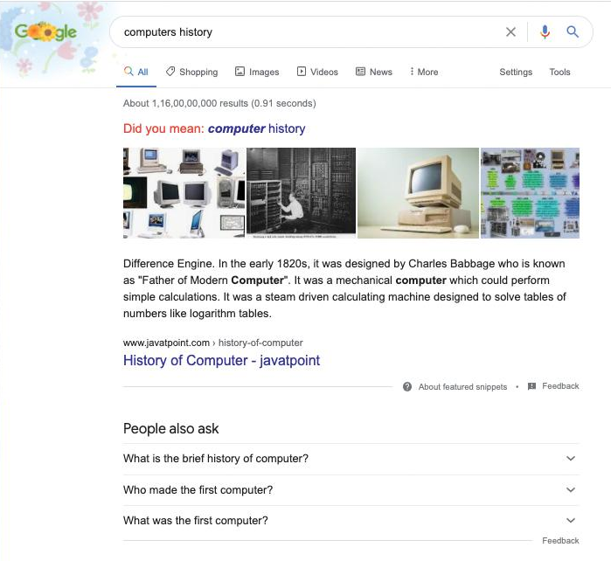
Google is the most popular search engine in the world

Slide 12

Activity 3.1:
Researching how to use the internet safely and responsibly

Slide 13
Digital wellbeing
Digital wellbeing is about having a healthy relationship with technology.
Research suggests that 11-year-olds spend up to 6 hours online every day.
Whether or not this is too much depends on the quality of the content you are looking at and activities you are doing online.
However, too much time spent online can affect your friendships, your health and your performance at school.

Slide 14
Digital wellbeing
What do you think the effects of spending too much time online might be?

Slide 15
Activity 3.2: Digital wellbeing

Slide 16
Quiz 3

